Slide 1
Deep Learning
Recurrent Neural Networks (RNNs)
Notes:
Introduction to the presentation on General Topic.

Slide 2
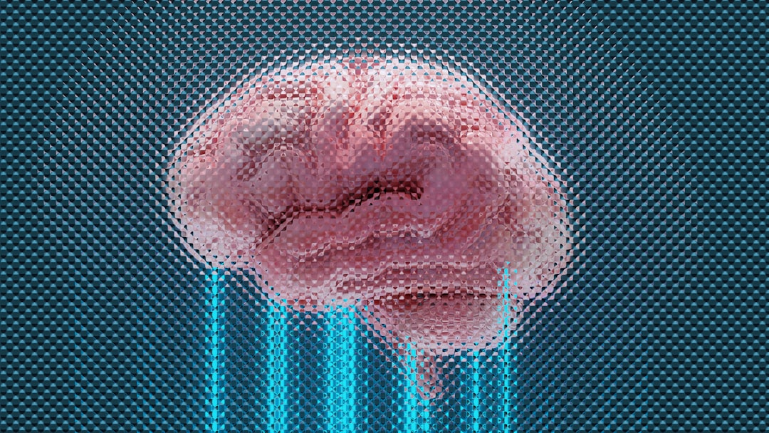
Intro/Background
RNNs process sequential data effectively
Applications in speech recognition and language modeling
Time-series forecasting and predictions also utilize RNNs
Understanding RNNs is crucial for deep learning advancements
RNNs have feedback connections, allowing information retention
These networks can learn long-term dependencies in data
RNNs are a fundamental component of many AI systems
They can handle variable-length input sequences
RNNs are widely used in natural language processing tasks
Sequential data analysis relies heavily on RNNs
Notes:
Explain the importance of RNNs in deep learning, provide examples of sequential data, and ask students to think about real-world applications of RNNs, such as speech recognition systems.

Slide 3
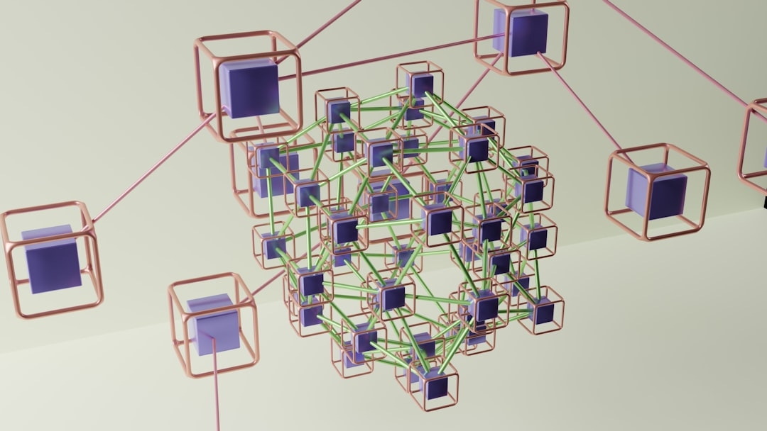
Architecture & Key Equation
RNN architecture consists of input, hidden, and output layers
Hidden layer has feedback connections for information retention
Output layer generates predictions based on input and hidden state
Key equation: h_t = tanh(W_h * h_(t-1) + W_x * x_t)
Weight matrices W_h and W_x are learned during training
Bias terms can be added for improved model performance
Activation functions like sigmoid or ReLU can be used
RNNs can be trained using backpropagation through time
Image query: a simple RNN architecture diagram
Notes:
Describe the basic RNN architecture, explain the key equation, and provide examples of how the weights and biases are learned during training. Ask students to think about the implications of using different activation functions.

Slide 4
Variants
LSTM (Long Short-Term Memory) networks: handle vanishing gradients
GRU (Gated Recurrent Unit) networks: simpler and faster than LSTMs
Bidirectional RNNs: process input sequences in both directions
Deep RNNs: multiple hidden layers for improved performance
Residual connections: improve training and performance of deep RNNs
Attention mechanisms: focus on specific parts of input sequences
Recurrent Highway Networks: another variant for improved performance
Gated Feedback RNNs: handle long-term dependencies effectively
Tree-structured RNNs: process hierarchical data structures
Notes:
Explain the different variants of RNNs, their strengths and weaknesses, and provide examples of when each variant is suitable. Ask students to think about the trade-offs between complexity and performance.

Slide 5
Applications + Advantages/Limitations
Speech recognition: RNNs can learn patterns in audio data
Language modeling: RNNs can predict next words in a sentence
Time-series forecasting: RNNs can predict future values
Advantages: handle sequential data, learn long-term dependencies
Limitations: vanishing gradients, slow training times
Applications in robotics, computer vision, and natural language processing
RNNs can be used for sentiment analysis and text classification
They can also be used for machine translation and dialogue systems
RNNs have many advantages, but also some significant limitations
Notes:
Discuss the various applications of RNNs, their advantages, and limitations. Provide examples of how RNNs can be used in different fields and ask students to think about the potential challenges and limitations of using RNNs in practice.

Slide 6
Summary
RNNs are a fundamental component of deep learning
They can handle sequential data and learn long-term dependencies
Variants like LSTM and GRU networks improve performance
Applications in speech recognition, language modeling, and time-series forecasting
Advantages: handle sequential data, learn long-term dependencies
Limitations: vanishing gradients, slow training times
Real-world applications: robotics, computer vision, natural language processing
RNNs have many advantages, but also some significant limitations
Future research directions: improving training times and performance
Notes:
Summarize the key takeaways from the previous slides, highlighting the importance of RNNs, their applications, advantages, and limitations. Ask students to think about the future research directions and potential improvements to RNNs, and provide examples of how RNNs can be used in practice.

